Slide 1

6th Grade Accelerated Math
Unit 5, Lesson 3 Exploring Rates Volume 1, pg. 183

Slide 2


Benchmark
MA.6.AR.3.2
Given a real-world context, determine a rate for a ratio of quantities with different units. Calculate and interpret the corresponding unit rate.
volume 1, pg. 183

Slide 3
Integrated Mathematical Thinking and Reasoning Standards
MA.K12.MTR.2.1 Demonstrate understanding by representing problems in multiple ways.
volume 1, pg. 183

Slide 4

Learning Targets
I can use ratios and rates to describe relationships between quantities.
I can write a ratio as a unit rate.
volume 1, pg. 183

Slide 5

Warm-Up
volume 1, pg. 184

Slide 6
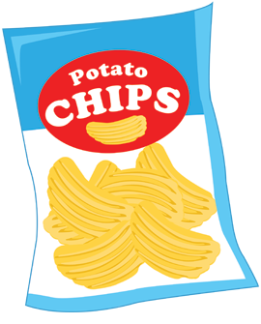


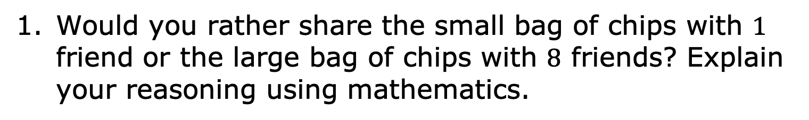
5.3.1 Warm-Up: Would You Rather?
Would you rather share the small bag of chips with $1$ friend or the large bag of chips with $8$ friends? Explain your reasoning using mathematics.
$8$ ounces
$1.5$ ounces
volume 1, pg. 184

Slide 7

Collaboration
volume 1, pg. 184

Slide 8
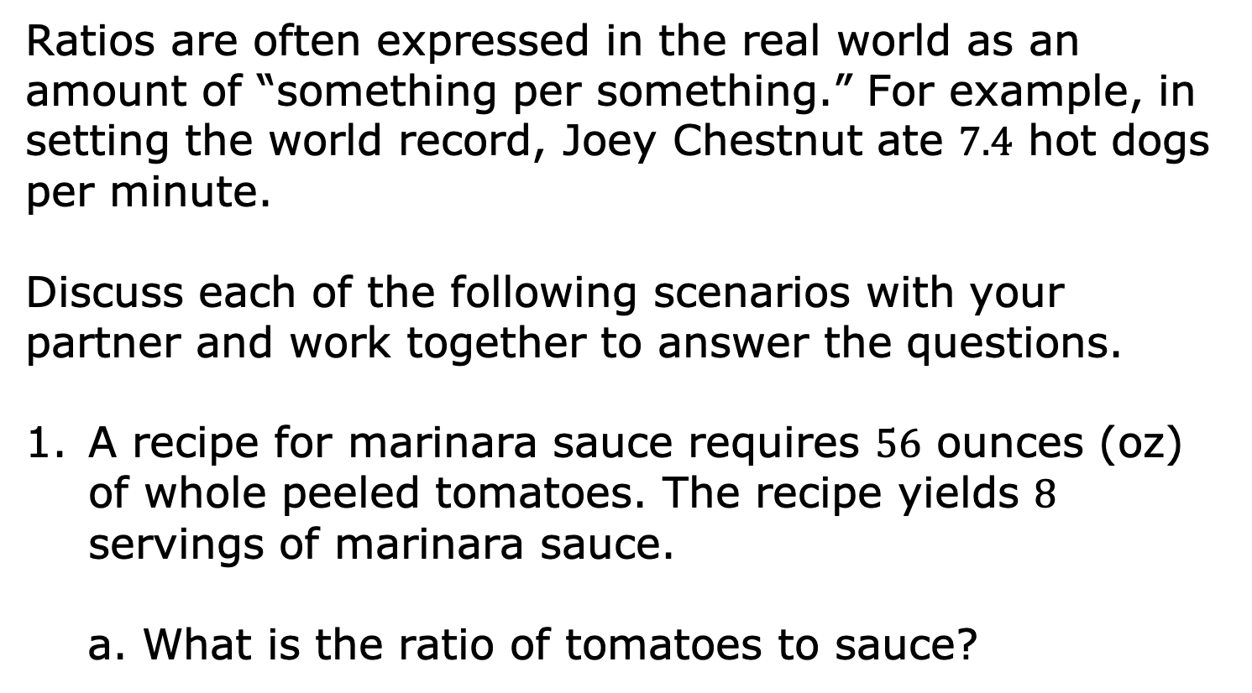
5.3.2 Collaboration: Expressing Ratios in Different Ways
Ratios are often expressed in the real world as an amount of “something per something.” For example, in setting the world record, Joey Chestnut ate $7.4$ hot dogs per minute.
Discuss each of the following scenarios with your partner and work together to answer the questions.
A recipe for marinara sauce requires $56$ ounces (oz) of whole peeled tomatoes. The recipe yields $8$ servings of marinara sauce.
What is the ratio of tomatoes to sauce?
volume 1, pg. 184

Slide 9

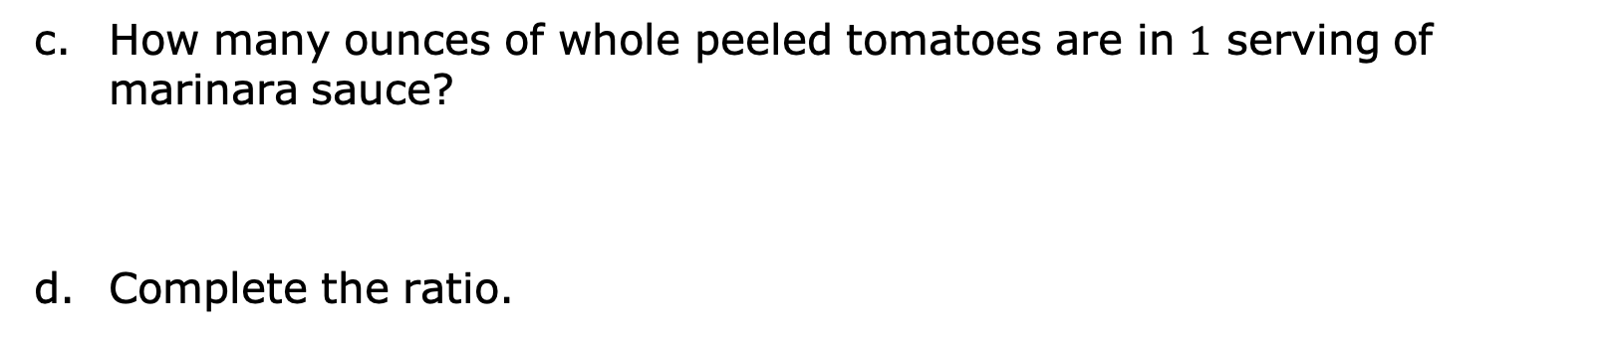
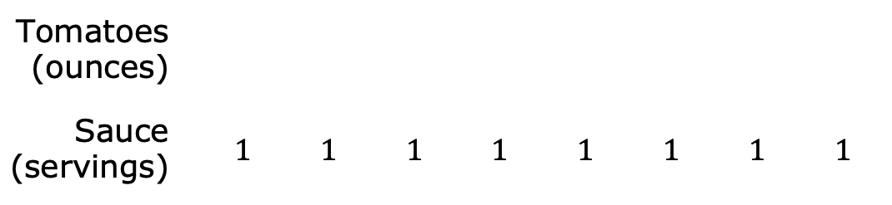
Complete the tape diagram to represent the ratio of tomatoes to sauce.
Tomatoes (ounces)
Sauce (servings) |  | $$1$$ | $$1$$ | $$1$$ | $$1$$ | $$1$$ | $$1$$ | $$1$$ | $$1$$
How many ounces of whole peeled tomatoes are in $1$ serving of marinara sauce?
Complete the ratio.
$$\frac{__________oz of tomatoes}{1 serving}$$
volume 1, pg. 184

Slide 10
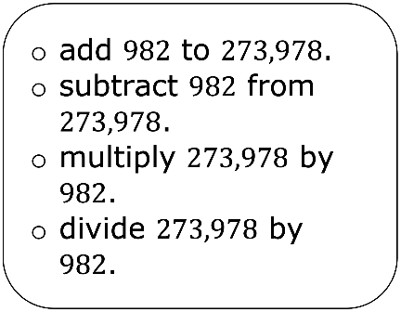
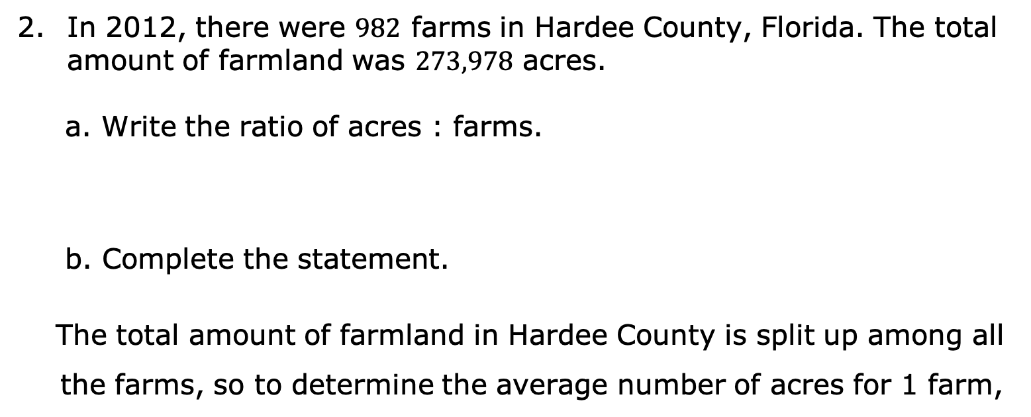
In 2012, there were $982$ farms in Hardee County, Florida. The total amount of farmland was $273,978$ acres.
Write the ratio of acres : farms.
Complete the statement.
The total amount of farmland in Hardee County is split up among all the farms, so to determine the average number of acres for 1 farm,
volume 1, pg. 185

Slide 11

Complete the ratio.
$$\frac{__________acres}{1 farm}$$
Discuss with your partner whether you think this number of acres per 1 farm means that every farm in Hardee County was that size in 2012. Then, write a brief summary of your reasoning.
volume 1, pg. 185

Slide 12

Guided Instruction
volume 1, pg. 185

Slide 13

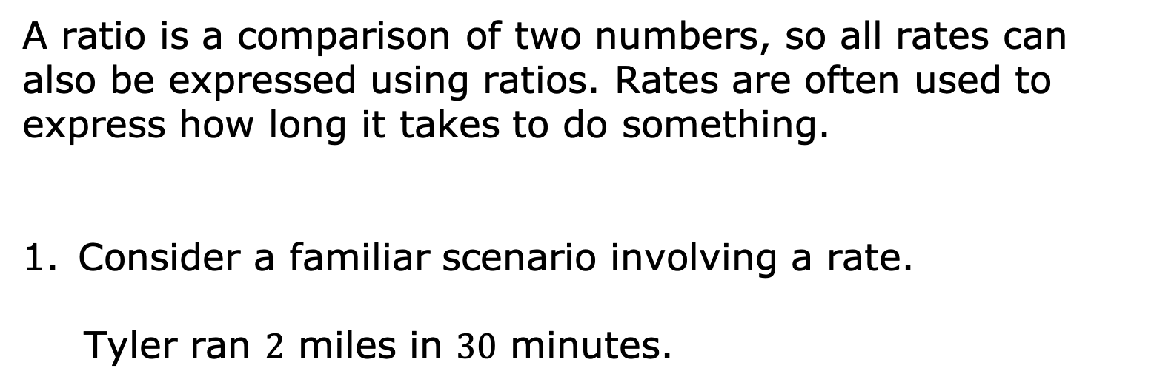
5.3.3 Guided Instruction: Understanding Rates
Each of the ratios discussed so far in this lesson are also rates.
A rate is a ratio that compares two quantities of different units.
A ratio is a comparison of two numbers, so all rates can also be expressed using ratios. Rates are often used to express how long it takes to do something.
Consider a familiar scenario involving a rate.
Tyler ran $2$ miles in $30$ minutes.
volume 1, pg. 185

Slide 14

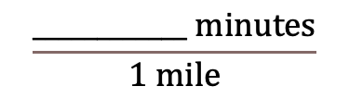

Draw a tape diagram for the ratio that represents Tyler’s run.
Complete the ratios. Then, complete each statement to interpret the ratios.
$$\frac{____________ miles}{1 minute}$$
$$\frac{____________ minutes}{1 mile}$$
Tyler runs ______ miles for every $1$ minute.
Tyler runs ______ minutes for every $1$ mile.
volume 1, pg. 185

Slide 15

Discuss with your partner how to use one of the rates to determine how many miles Tyler runs in an hour. Then, complete the statement.
Tyler runs ______ miles per hour.
Each of the rates used to describe Tyler’s run is a unit rate.
A unit rate is a ratio comparing a number of units of one quantity to $1$ unit of a second quantity.
volume 1, pg. 186

Slide 16

Guided Practice
volume 1, pg. 186

Slide 17

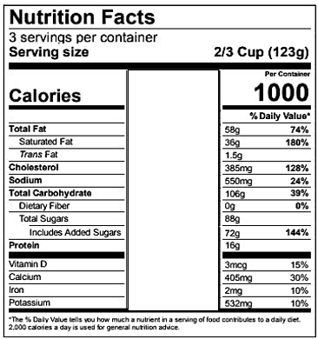
5.3.4 Guided Practice: Using Ratios and Rates
A nutritional label for raspberry ice cream is shown.
volume 1, pg. 186

Slide 18

What is the ratio of calories to servings?
What is the ratio of total carbohydrates in the container to the number of calories in the container?
What is the ratio of added sugars to the number of servings?
Complete the unit rate to express the number of added sugars per serving.
$$\frac{________ grams}{1 serving}$$
volume 1, pg. 186

Slide 19

Your Turn
volume 1, pg. 187

Slide 20

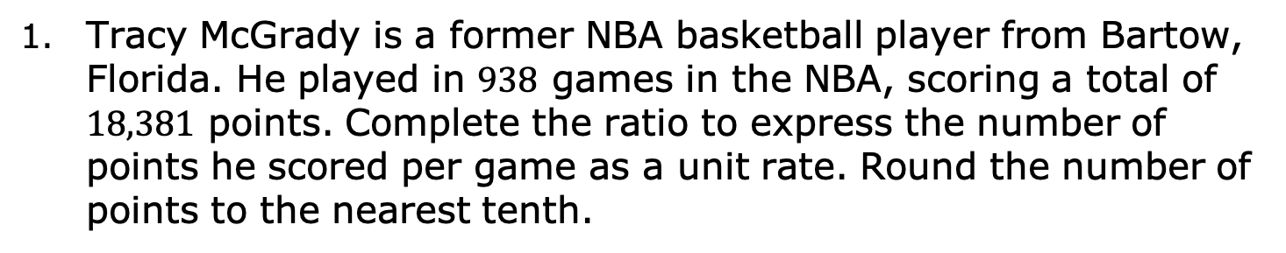
5.3.5 Your Turn!
Tracy McGrady is a former NBA basketball player from Bartow, Florida. He played in $938$ games in the NBA, scoring a total of $18,381$ points. Complete the ratio to express the number of points he scored per game as a unit rate. Round the number of points to the nearest tenth.
$$\frac{________ points}{1 game}$$
volume 1, pg. 187

Slide 21
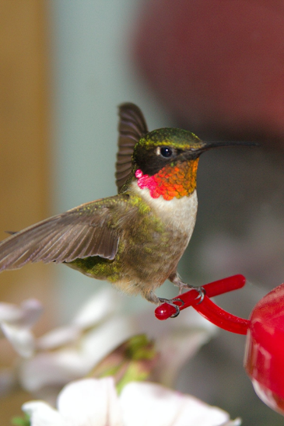
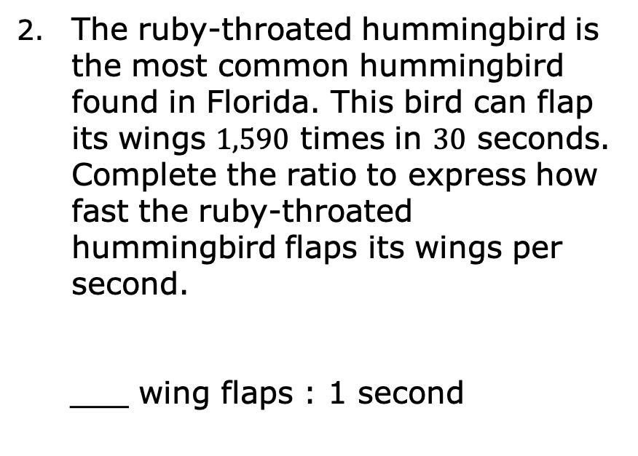
The ruby-throated hummingbird is the most common hummingbird found in Florida. This bird can flap its wings $1,590$ times in $30$ seconds. Complete the ratio to express how fast the ruby-throated hummingbird flaps its wings per second.
___ wing flaps : 1 second
volume 1, pg. 187

Slide 22

Wrap-Up
volume 1, pg. 187

Slide 23

5.3.6 Wrap-Up: Reflection
Complete the stoplight reflection to share how you are feeling about the concepts learned in today’s lesson.
I still feel stuck about how to …
I’m starting to get the hang of …
I feel confident and ready to go with …
volume 1, pg. 187

